Slide 1
Dashboard Introductory Hands-On Exercise
Data Visualization
John F. Tripp

Slide 2
Dashboard Best Practices
Before you start on a dashboard, you must know the purpose and audience.
  This will drive the type of dashboard that you build.
  We will now do a “basic” hands on for an executive dashboard.

Slide 3
Dashboard Hands-On
Open the workbook Basic Dashboard – Start Point.twbx
  Take a few moments to look at the graphs.
    All (except the first) are incomplete.
    Some are more incomplete than others

Slide 4
Dashboard Hands-On
First, we’ll need to make a couple of the graphs more complete.
  For the Top 5 and Bottom 5 graphs, filter them so that they show the appropriate data.
  Add a filter, and use the functionality of the filter to display either the top 5 or bottom 5 by profit.
  HINT: The filter pill that you need is NOT the profit pill.
  Sort the results appropriately.
  (These are not completed yet)

Slide 5
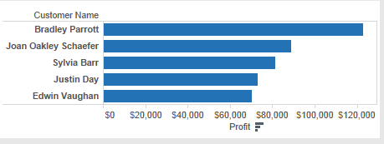
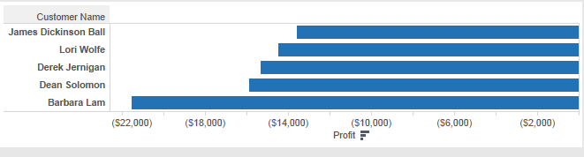

Slide 6
Dashboard Hands-On
Now we will create the dashboard.
Create a new dashboard and add all of the screens, as shown on the next slide.

Slide 7
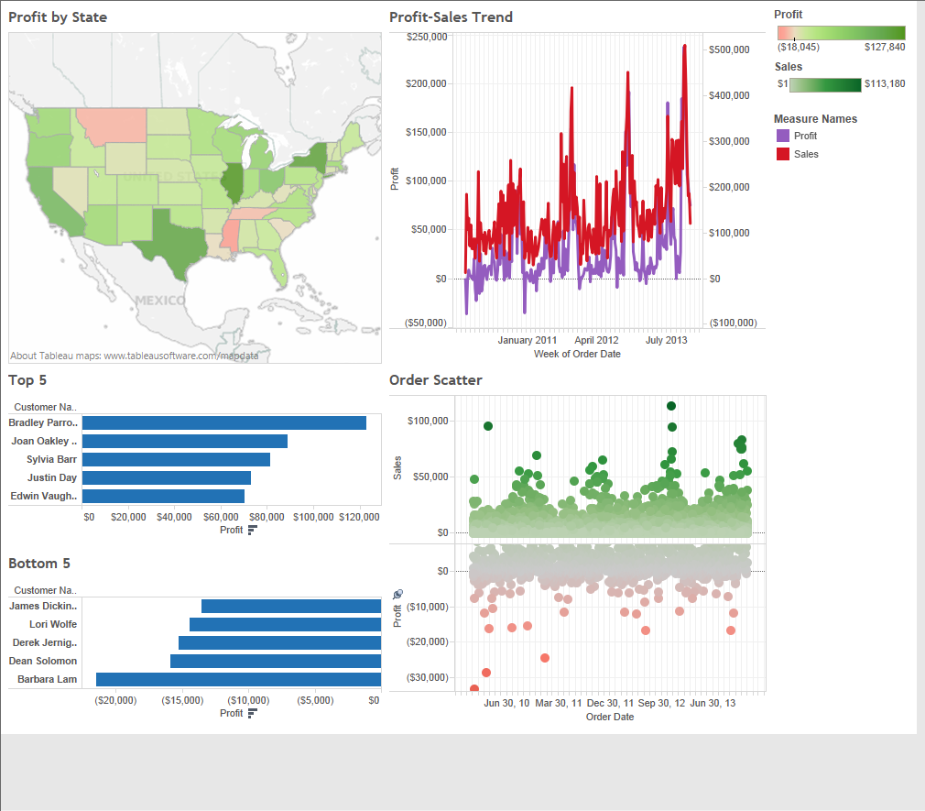

Slide 8
Dashboard Hands-On
There are some issues with the way some of the data is being visualized.
  Let’s look at some of the biggest issues…

Slide 10
Dashboard Hands-On
Some selected issues
  Trend is too detailed (need to smooth in an appropriate fashion)
  Top 5 and Top 10 are same color, different directions, scales are inconsistent.
  Date range displayed (all data) is most likely not needed for main dashboard view.
  Let’s fix these.

Slide 11
Dashboard Hands-On
Current issues (selected) - fixes
  Smooth the trend chart by displaying data by week.
  Make the bottom 5 display as red.
  Reverse the scale of the bottom 5
  Make the scales consistent on the top 5 and bottom 5

Slide 12
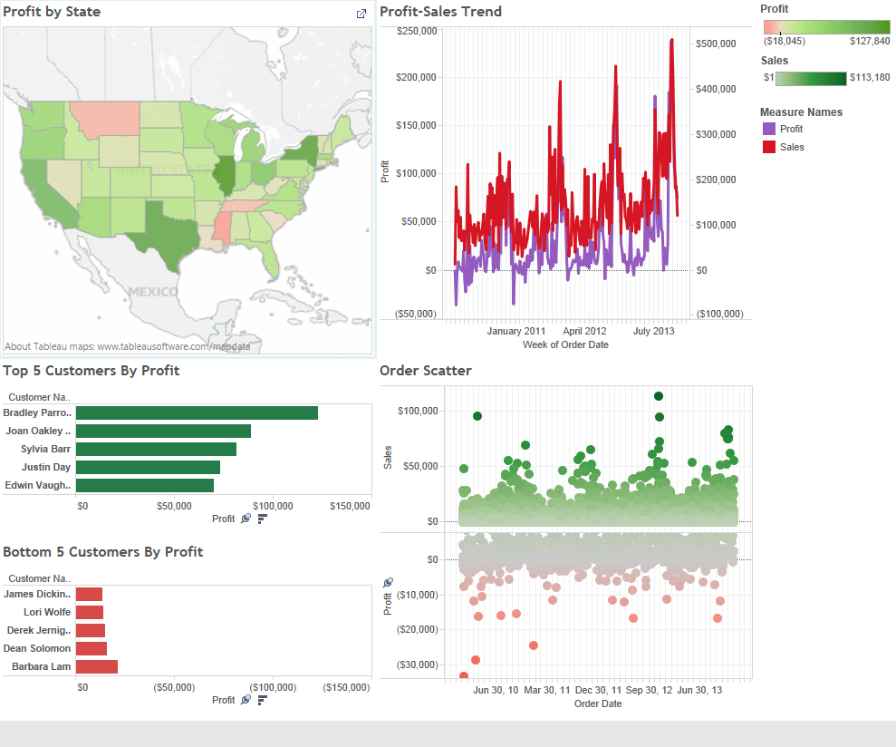

Slide 13
Dashboard Hands-On
Current issues (selected) - fixes
  Add a quick filter to the dashboard that allows for the dashboard to display relative dates (using Order Date)
  Make sure that all of the worksheets are affected by the Quick Filter
  (This is still not right, but we need to do this in steps)

Slide 14
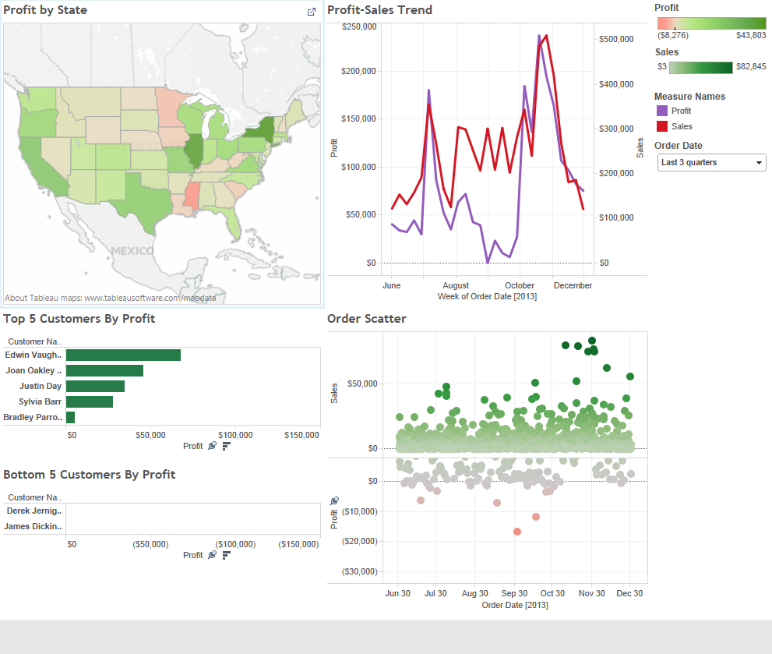

Slide 15
Dashboard Hands-On
There are still issues.
  What are the issues that still remain?
  The order date filter doesn’t seem to be working quite right
  There are still clickable things in the dashboard that don’t affect the entire dashboard.
  There is missing detail.

Slide 16
Dashboard Hands-On
When building a dashboard, the relationships between the various elements must be fully explored.
When building a dashboard, you need to be aware of its affordances.

Slide 17
Affordance Theory
A key theory of perception
Objects, whether physical or digital provide hints as to their properties.
Based upon your experience, you perceive those properties to “afford” action
  Ball – “graspability”, “throwability”.
  Hammer – “graspability”, “strikability”
  Chair – “sitability”

Slide 18
Affordance Theory
Affordances are a categorization mechanism
Your experience trains you that chairs hold you when you sit – you do not need to test whether this is true for every new chair you see
  (Unless you’re REALLY heavy).
Digital dashboards are the same

Slide 19
Affordance Theory
The elements of a dashboard tend to afford “clickability”, and the concept is that if I click one portion of the dashboard, the others will “respect” that click.
  Customer
  State
  Order

Slide 20
Tableau and Clickability
In order to enable all of the elements of the dashboard (that you want), to be clickable, you don’t need to do anything.
In order to make the clicks affect the other elements, you need to make each element itself a filter.

Slide 21
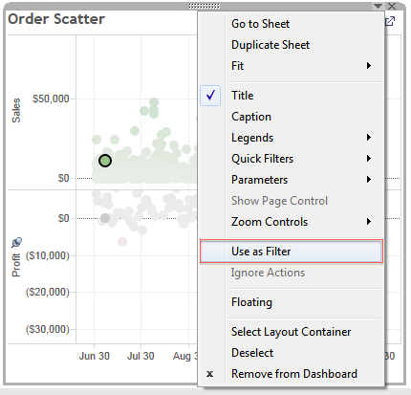

Slide 22
Dashboard Hands-On
Go ahead and enable clickability by choosing “use as filter” on all the panes.
At this point, this will create some even more bizarre functionality. We will fix that soon.

Slide 23
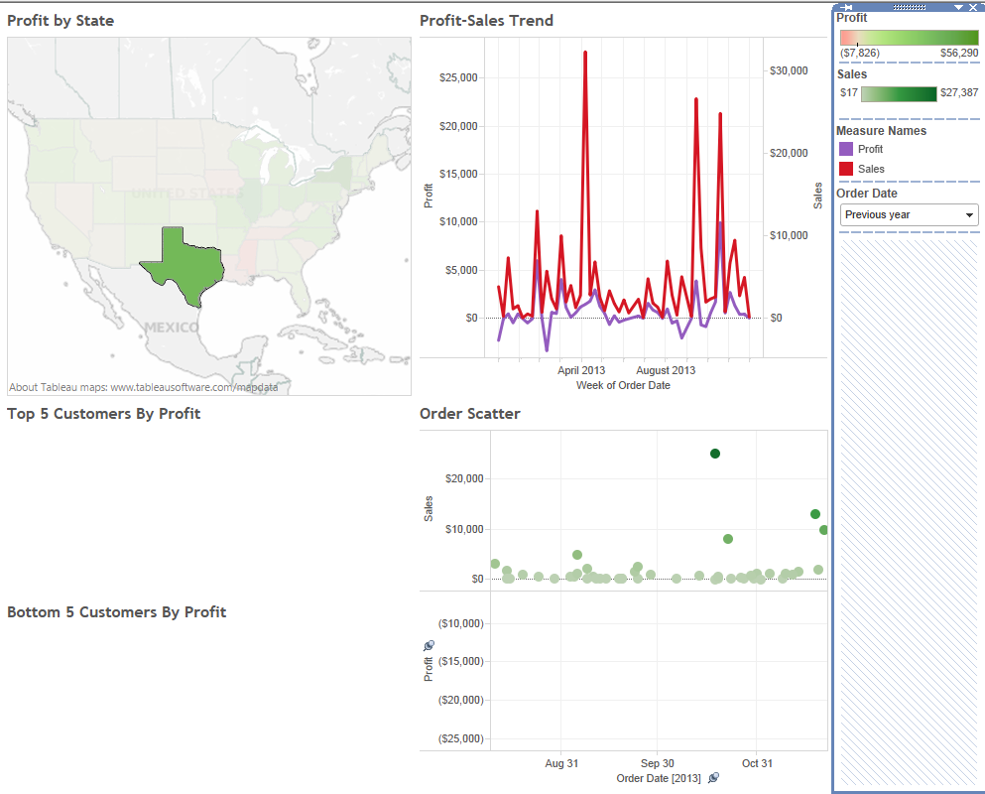
I filtered by current year and clicked on Texas to create this view.

Slide 24
Filters & Context
Our problem right now is that all of the filters are not working together.
Filters respect a particular “order of operations”
  Data Source
  Extract
  Context
  Dimension
  Measure
    See “Filtering in Tableau” Lecture for more information.
Let’s look at the dashboard

Slide 25
Filters & Context
In this case, we need to modify the order that the filters are being executed.
To do this, you need move some of the filters to the “context”.
  See “Filtering in Tableau” Lecture for more information.

Slide 26
Dashboard Hands-On
In order to filter all of the data on the dashboard by state, you need to add the context filters to all of the panes.
  So we need to add country and state to all of the panes, then we need to make them “context filters”
  Make sure that you choose “United States” for the Country, and “All” for the states.
  We also need to make “Order Date” a context filter.

Slide 27
Dashboard Hands-On
Finally, add a drop down quick filter on country on the dashboard.
  Make sure it applies to all elements.

Slide 28
